Slide 1
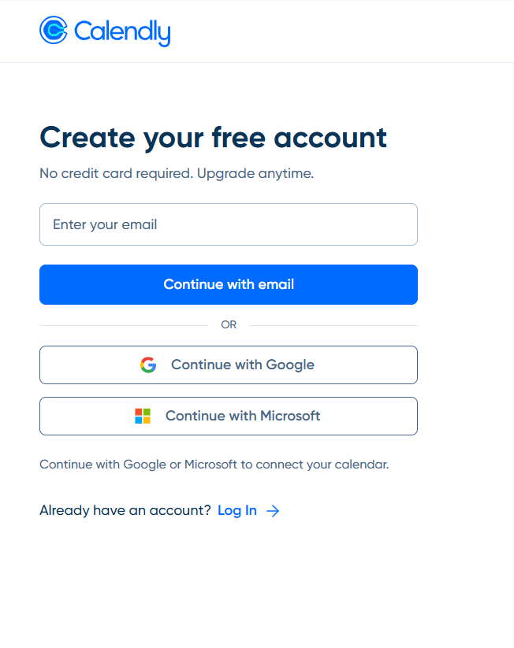
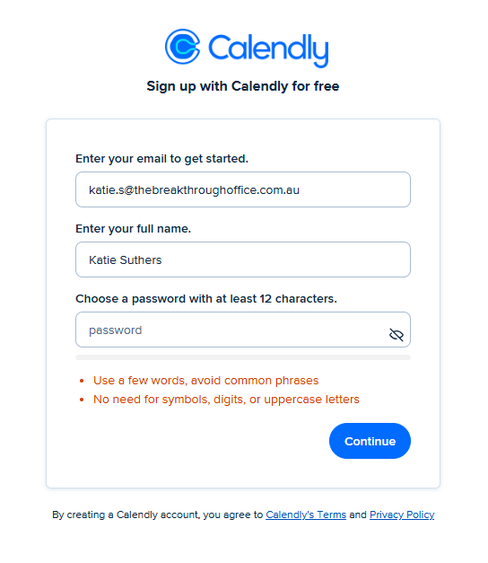

Setting up Calendly
How to set up your Calendly account:
Head to the Calendly website (calendly.com) and click ‘Get started’. Or click on the accept invitation link from your emails.
Then enter your email address and press ‘continue with email’.
Enter your name and a password.

Slide 2
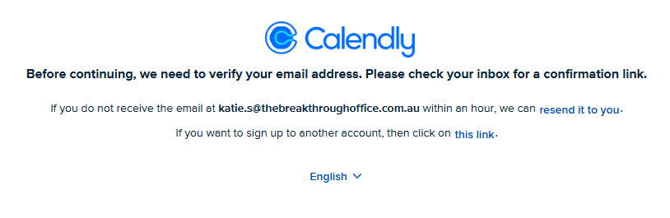
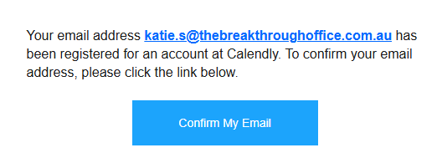
Setting up Calendly
You will then receive an email with a confirmation link, when this comes through, click ‘Confirm my email’.
The link will then prompt you to enter your password.

Slide 3
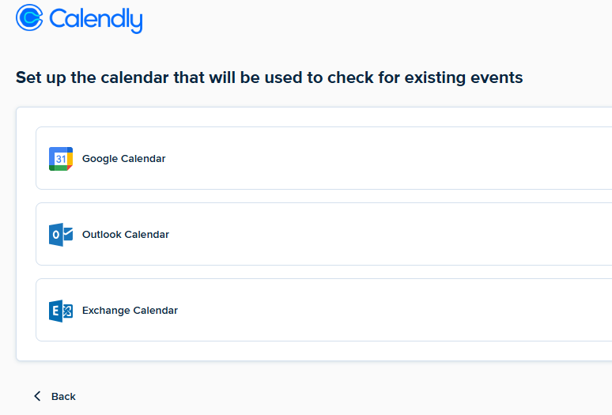
Setting up Calendly
Follow the prompts until you get to the calendar set up page.
Connect Outlook calendar and select your email.

Slide 4
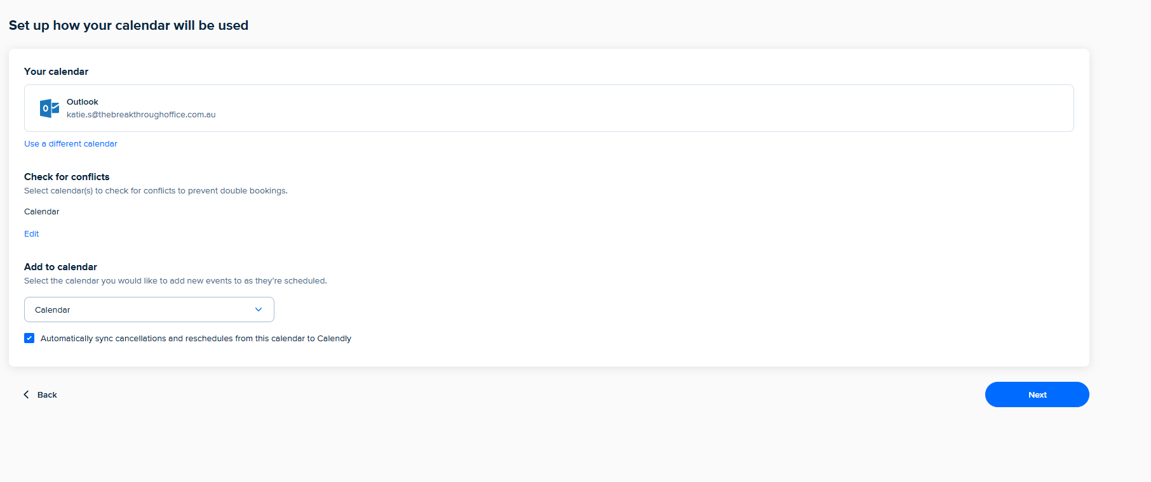
Setting up Calendly
This should bring up the below screen, select ‘Next’:

Slide 5
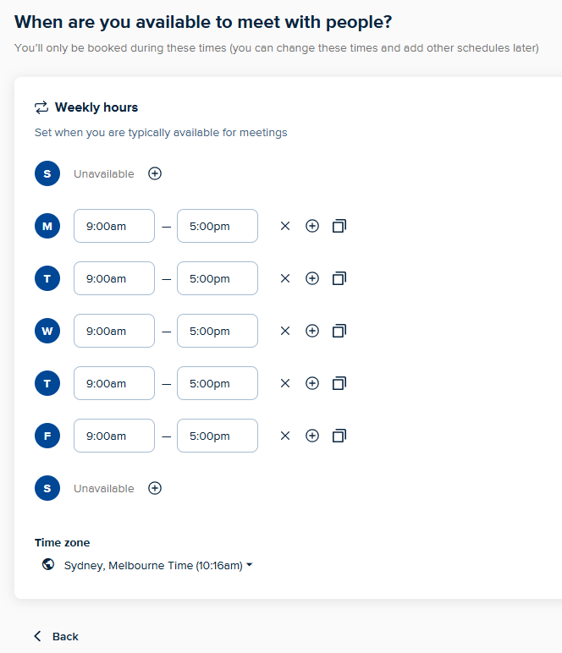
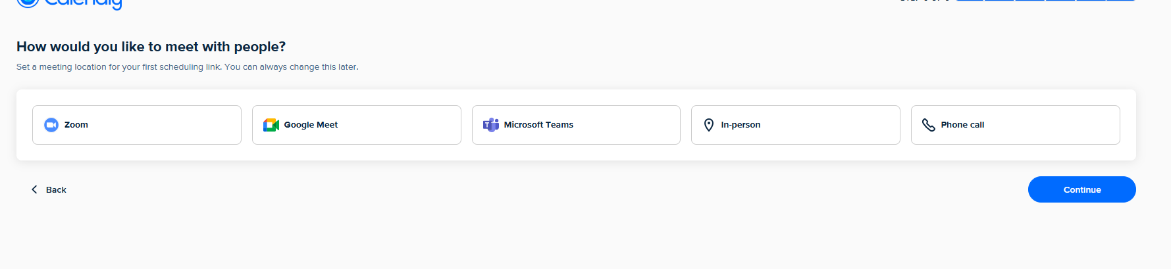
Setting up Calendly
Add in your working hours.
Then select ‘Microsoft Teams’ and connect Teams.

Slide 6
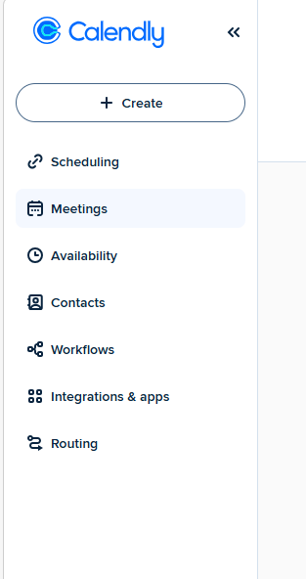
Setting up Calendly
Note- you will then need to enter justification for downloading this. Just add in a brief comment (e.g. client meetings) and the request will go to Exec to approve.
Once approved, you can then start using Calendly.

